Slide 1
Edge
RESTful API Design

Slide 2
Key Questions
Plan for a “great” first impression, don’t disappoint App developers
What RESTful maturity level are you seeking?
Is your API design independent of backend system details?
Do you expect to externalize the APIs? It’s a good idea to plan for this.
Are third party APIs expected to be consumed directly or via Edge proxies?

Slide 3
design [dəˈzīn]
The creation of a plan or convention for the construction of an object, system or measurable human interaction.
Designing often necessitates considering the aesthetic, functional, economic, and sociopolitical dimensions of both the design object and design process. It may involve considerable research, thought, modeling, interactive adjustment, and re-design.

Slide 4
architecture [ˈärkəˌtek(t)SHər]
The complex structure of something.

Slide 5
Designing is: A plan or convention for a measurable human interaction
Dimensions
Aesthetic
Functional
Economic
Sociopolitical
Activities
Research
Thought
Modeling
Interactive Adjustment
Re-design

Slide 6
Architecture is: A plan or construct for partitioning the implementation of a system
Dimensions
Organizational
Data
Function
Process
Activities
Data Flow Diagrams
Data Mapping
Security Constructs
Capacity Planning
Storage
Network
Compute

Slide 7
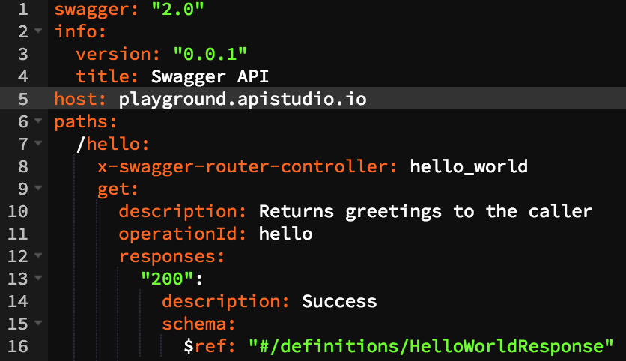
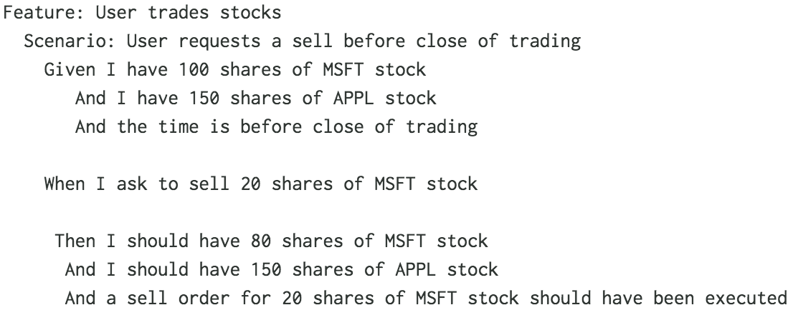
Key Outputs by the Designer
OpenAPI Specification
Given/When/Then (Gherkin style) test scenarios
* Traditional PRD/BDD documents do not add value to the API implementation process.

Slide 8
Key Outputs by the Architect
Data flow diagrams
Sequence diagrams
Common security policies
Authentication / Authorization
Quotas
Designs for other cross-cutting concerns (e.g. logging)
Cross-cutting concerns tests using Given/When/Then (Gherkin style)
Security
Quota
Network and physical infrastructure plans

Slide 9
Building Blocks of REST

Slide 10
What is REST?
REST is an acronym for "Representational State Transfer".
REST is a mechanism for using standard HTTP concepts to access machine readable resources.
REST allows programmers to access web APIs with very little overhead.
A well-written REST API is easily understandable, readily consumable and self-documenting.

Slide 11
What does REST look like?
Resource-Oriented
/v1/customers - a collection of or search for customers
/v1/customers/{} - a specific customer
HTTP Verb Driven
GET - fetch / search
POST - create
PUT - update
DELETE - remove

Slide 12
Why REST?
Well understood in the industry
Readily implementable
Readily consumable
Lifecycle tools
Governance tools

Slide 13
Benefits of Resource-Oriented,
Verb-Driven APIs
Clear intent, common understanding
HTTP caching tricks enabled
ETag
If-Modified-Since
Cache-Control
Security, Logging, Analytics & more orthogonal to protocol

Slide 14
Data Types
XML
The “Traditional” enterprise data structure type
Strong validation = brittle apps
Difficult implementation on mobile / web platforms
JSON
Web-native data structures
Weak validation = robust apps
Seamless implementation on mobile / web platforms

Slide 15
Sample Interaction
GET /v1/customers HTTP/1.1
Host: api.yourdomain.com

Slide 16
Sample Interaction
400 Bad Request
{
"message": "query missing",
"parameter: "q"
}
GET /v1/customers HTTP/1.1
Host: api.yourdomain.com

Slide 17
Sample Interaction
GET /v1/customers/U3443 HTTP/1.1
Host: api.yourdomain.com

Slide 18
Sample Interaction
200 OK
Cache-Control: max-age=35000
Last-Modified: Wed, 21 Dec 2016 08:12:31 MDT
{
"fname":"Fred", "lname":"Jones",
"id":"U3443",
"address": {
"line1":"455 Weaver Park Rd #500",
"city":"Longmont",
"state":"CO",
"zip":"80501"
},
"orders": {
"href":"https://.../v1/orders?cust=U3443"
}
}
GET /v1/customers/U3443 HTTP/1.1
Host: api.yourdomain.com

Slide 19
Sample Interaction
GET /v1/customers/U3443 HTTP/1.1
Host: api.yourdomain.com
If-Modified-Since: Wed, 21 Dec 2016 08:12:31 MDT

Slide 20
Sample Interaction
GET /v1/customers/U3443 HTTP/1.1
Host: api.yourdomain.com
If-Modified-Since: Wed, 21 Dec 2016 08:12:31 MDT
304 Not Modified
Last-Modified: Wed, 21 Dec 2016 08:12:31 MDT

Slide 21
Response Codes & Pagination

Slide 22
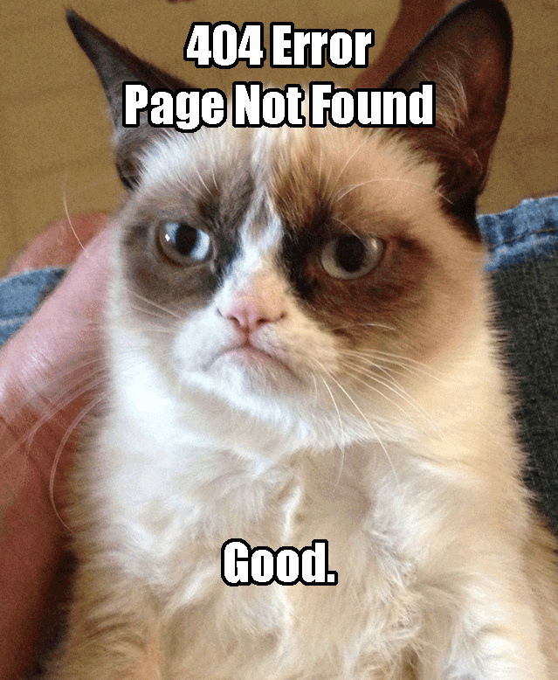

Response Codes
Communicating enough, but never too much.
Proprietary + Confidential

Slide 23
Response codes should communicate only what the developer consuming an API needs
It's not uncommon for a response code or message to accidentally divulge proprietary details from internal systems. Remember that response codes will be consumed by untrusted actors, and should communicate only what the developer needs to know to either correct the issue or alert the user, but no more.

Slide 24
Consider this scenario:
An actor requests a user profile by ID.
Users that don't exist at all are returned 404.
Users that do exist but aren't accessible return 403.
GET /users/U124
404 Not Found
GET /users/U123
403 Forbidden
Inadvertent leakage.
A malicious actor can use this information to determine which user ids are valid, and which are not assigned.
This information can be used to launch additional attacks.
A better approach:
All resources not accessible by the current user return 404 Not Found.

Slide 25
Consider this scenario:
An actor requests a resource by Object ID.
Resources that don't exist at all are returned 404.
Resources that do exist but aren't accessible return 401.
GET /product/P124
404 Not Found
GET /product/P123
401 Not Authorized
Inadvertent leakage.
A malicious actor can use this information to determine which resource ids are valid, and which are not assigned.
This information can be used to launch additional attacks.
A better approach:
All resources not accessible by the current user return 404 Not Found.

Slide 26
Seven Minimal Error Codes
200 OK Resource found, accessible and available. Action taken and response in payload.
201 Created Resource was created; payload contains new object (or reference to).
304 Not Modified No change since last request. Use cached copy.
400 Bad Request Request was missing required elements. Repair and resubmit.
401 Unauthorized User has not obtained any token. Include authorization instructions in return body.
404 Not Found No such resource accessible to current client / user.
500 Server Error Something went wrong behind the scenes. No change necessary on client.

Slide 27
Response Payloads: Only what the consumer needs to know.
Poor Examples
Better Examples
{ "400":"Bad Request" }
{ "400":"Bad Request",
"message":"See http://docs/api/the-resource" }
Provides no context for repair of the query
{ "500":"Internal Error",
"message":"Tibco failure in querying MySQL database on 10.3.4.33"}
{ "500":"Internal Error",
"message":"Report error by mailing errors@mycorp.com",
"correlationId":"C4444-23"}
Leaks information about internal network configuration

Slide 28

Pagination
Avoiding linear memory overflow since the 5th Century.
Proprietary + Confidential

Slide 29
When should pagination be used?
When to use pagination:
A large number of results in a list.
An unknown number of results in a list.
Results are of the same resource type.
Queries or listings.
When not to use pagination:
When the payload is not a list of objects.
Small, known number of results never to exceed a handful (e.g. 5-10)

Slide 30
Best Practice for Pagination.
Paged resources should have a metadata section that describes, at a minimum, the current page, the number of resources requested, and the number of resources in the current page listing.
{
"pagination": {
"page": 4,
"page_size": 10,
"items": 10
},
"items": []
}

Slide 31
A Helpful Idea
Include a URL for the next/previous page, so the developer intuitively knows how to fetch them.
{
"pagination": {
"page": 4,
"page_size": 10,
"items": 10,
"next": "https://.../resource?page=5&page_size=10",
"prev": "https://.../resource?page=3&page_size=10"
},
"items": []
}

Slide 32
Best Practice for Pagination.
The item list need not be the full item. Instead, consider what summary information is required for use & display. Include that, plus a link to the full item.
{
"pagination": {
"page": 4,
"page_size": 10,
"items": 10,
"next": "https://.../resource?page=5&page_size=10",
"prev": "https://.../resource?page=3&page_size=10"
},
"items": [
{ "id":"fjones123", "first_name":"Fred", "last_name":"Jones",
"href":"https://.../people/fjones123" },
{...},{...},...
]
}

Slide 33
Design Best Practices

Slide 34

Mission: The Most Important Design Influence
Always keep in mind why APIs are being implemented.
Proprietary + Confidential

Slide 35
Sample Mission:
Reduce time to market for new apps
More than just wrapping existing services
Development teams need:
Consistency in Interface Language
Sandboxes to test theories
Good Documents to determine how to use APIs
Uninterrupted Workflow to work out gnarly issues
Stable Environments to prove utility

Slide 36
Sample Mission:
Leverage external developers using public APIs
Developers need:
Consistency
Automated onboarding
Great documentation and examples
Testing environments
Production promotion workflow
Support community
A payoff

Slide 37
Tips for Success
Spend 70% of your design effort on APIs that have consumers who can tell you if what you're designing is useful (or not).
Spend more time thinking about resources that are used, not actions that are taken. Nouns are good; verbs are bad.
Before designing a new API, first evaluate the current portfolio and see if a modification can be made to an existing API to satisfy the need.

Slide 38
More Tips
Non-functional requirements such as security schemes, SLA, or latency timing, while important, should not be allowed to impact the design.
Avoid the urge to implement custom anything. To the greatest extent possible, use conventions and techniques already in place.

Slide 39

An API is like a joke. If you have to explain it, it's not that good.
Paraphrased Martin LeBlanc
Proprietary + Confidential

Slide 40
Best Practice 1:
Noun-Oriented Resources
Keep primary resources to 2 levels
Force VERBs out of the URI
Use HTTP verbs (GET/POST/PUT/DELETE) on collections and elements
Use plural nouns for collections
Prefer concrete names over abstractions
https://myserver/v1/dogs
https://myserver/v1/dogs/{dog-id}

Slide 41
Best Practice 2:
Force Verbs Out of URIs
Verbs in the URI cause a long list of URIs with no consistent pattern.
/getAllDogs
/verifyDogLocation
/isFeedNeeded
/giveDirectOrder
/getDog
/newDog
/getNewDogsSince
/getRedDogs
/setDogStateTo
/getAllLeashedDogs
/createRecurringMedication
/getHungerLevel
/getSquirrelChasingPuppies
/newDogForOwner
/transferDog
/doDirectOwnerDiscipline
/getRecurringFeedingSchedule
/isDogSick
/getDogsAtPark
/feedADog
/getSittingDogs
/checkHealth

Slide 42
Best Practice 3:
Use HTTP Verbs to Manage CRUD Operations
Resource | POST create | GET read | PUT update | DELETE delete
/dogs | Create a new dog | List matched dogs | Bulk update matched dogs | Delete all matched dogs
/dogs/1234 | Error | Show "Oreo" | If exists, update "Oreo" If not, error! | Delete "Oreo"

Slide 43
Best Practice 4:
Sweep Complexity Behind the ' ? '
vs.
Relationships can be complex. Use query parameters instead of complex pathing.
Which would you rather use?
Which is more performant in bandwidth and compute constrained client environments?
GET /parks
For each park: GET /parks/{park-id}/dogs
For each dog: GET /dogs/{dog-id} (filter out dogs not running & not grey)
GET /dogs?color=grey&state=running&location=park

